Slide 1
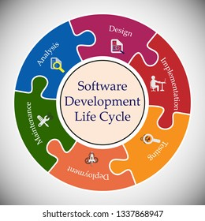
SOFTWARE DEVELOPMENT LIFE CYCLE
BY
S.SAI KIRAN.

Slide 2
WHAT IS SDLC?
The software development lifecycle (SDLC)
The cost-effective and time-efficient process that development teams use to design and build high-quality software.

Slide 3
Why is SDLC important?
Increased visibility of the development process
Efficient estimation, planning, and scheduling
Improved risk management and cost estimation
Systematic software delivery and better customer satisfaction

Slide 4
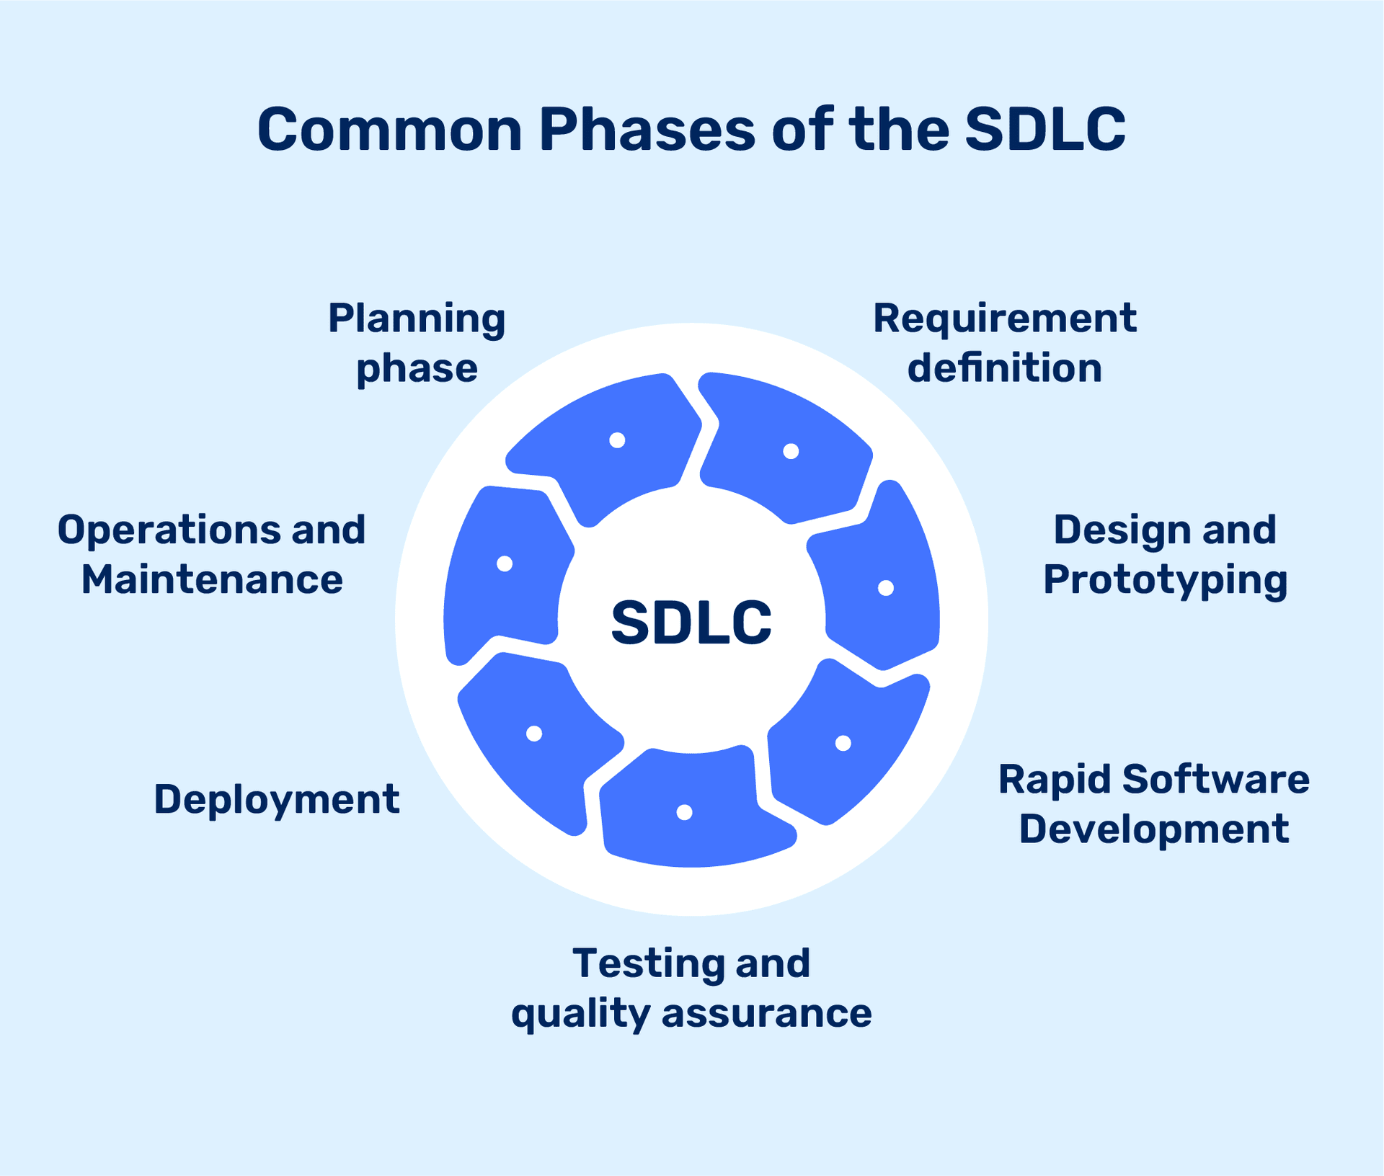

Slide 5
How does SDLC work?
Plan
Design
Implement
Test
Deploy
Maintain

Slide 6
What are SDLC models?
Waterfall model
Traditional approach of software development.
Development happens in a step by step manner.
Requirement Analysis
2. Design
3. Development
4. Testing
5. Maintenance

Slide 7
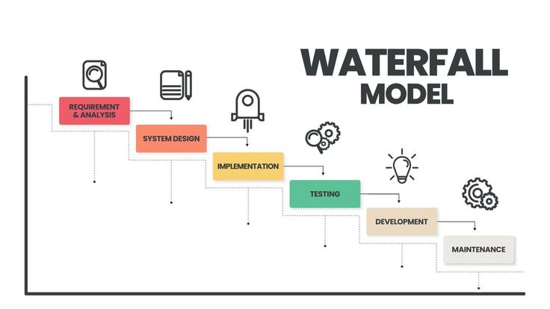

Slide 8
Disadvantages of waterfall model?
Any new requirement from the client will restart the development.
In waterfall model client requirements can’t be understood at once.
Software must be delivered faster and with less resources.
It is also very expensive to make changes during the end of the
project.

Slide 9
AGILE MODEL?
Programmers create prototype to understand client requirement.
Client provides feedback and list of changes to be made.
The entire process of building a software is broken down into small actionable
blocks called sprints.

Slide 10
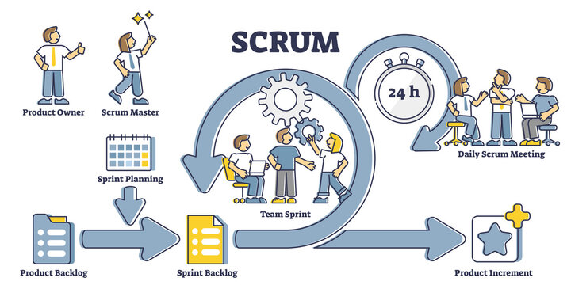

Slide 11
ADVANTAGES:
Client Requirement are better understood because of the constant feedback.
Product is delivered much faster as compared to waterfall model.
DISADVANTAGES:
The product gets tested only on developer computers and not on production
systems.
Developers and operations team work in silos.

Slide 12
WATERFALL MODEL:
No communication between client and Developer.
AGILE MODEL:
No communication between Developer and operations team.

Slide 13
DEVOPS:
Devops addressed the gap between developers and operations.
Automate and integrate software development and IT operations.
Deliver faster, more reliable, and continuous updates.
Faster delivery of features and fixes.
Improved collaboration between Dev and Ops
Higher software quality and reliability.
Continuous improvement.

Slide 14
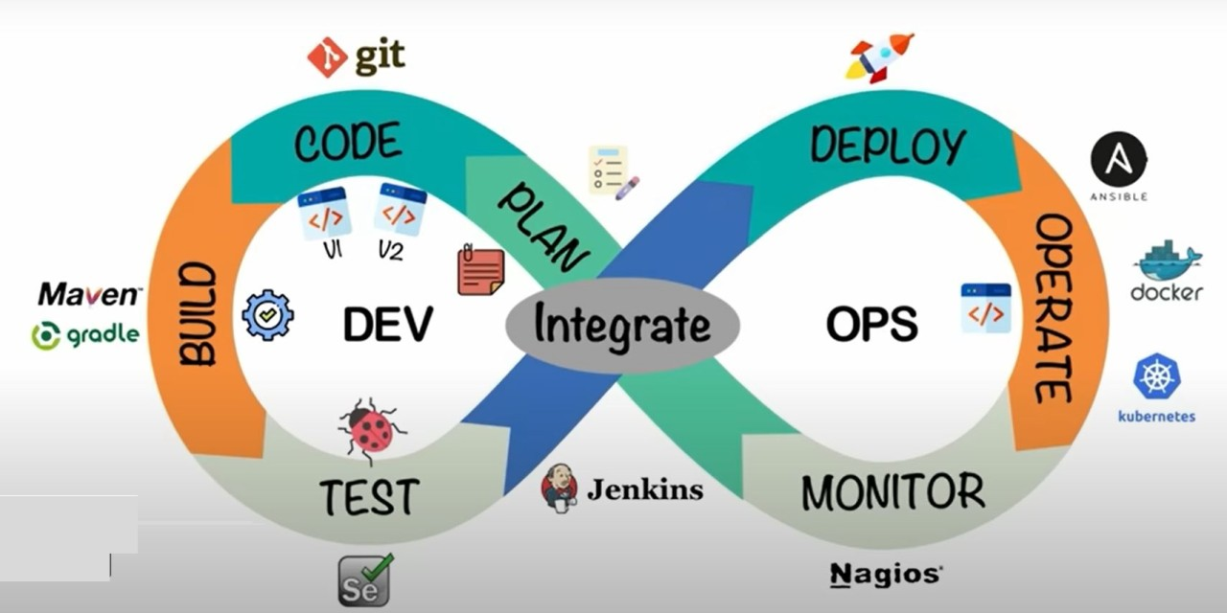

Slide 15
DEVOPS PHASES:
Plan
Code
Build
Test
Integrate
Deploy
Operate
Monitor

Slide 16
DEVOPS TOOLS:
Function | Tools
CI/CD Pipelines | Jenkins, GitHub Actions, GitLab CI
Source Control | Git, GitHub, GitLab
Containerization | Docker
Orchestration | Kubernetes
Infrastructure as Code | Terraform, AWS CloudFormation
Monitoring | Prometheus, Grafana, ELK Stack

Slide 17
ADVANTAGES:
Time taken to create and deliver software is reduced.
Complexity of maintaining an application is reduced.
Improved collaboration between developers and operations team.
Continuos integration and delivery ensure faster time to market.

Slide 18
WHAT ARE DEPLOYMENT METHODOLOGIES:
Deployment :
The process of releasing the software to the production environment.
Goal :
Deliver working software to the users.

Slide 19
TYPES OF DEPLOYMENT STRATEGIES:
Blue-Green Deployment.
Canary Deployment.
Rolling Deployment.
Incremental Deployment.
Phased Deployment.

Slide 20
SDLC VS DEPLOYMENT:
SDLC is the roadmap for the ideation for development.
Deployment is the act of delivering to the final product to users.
Both are essential for successful software delivery.

Slide 21
THANK YOU

